Slide 1



The Stellar Population of Metal−Poor Galaxies at z~1
Andrew Weldon, Honors Junior, Astronomy and Physics
Dr. Chun Ly, Steward Observatory

Slide 2
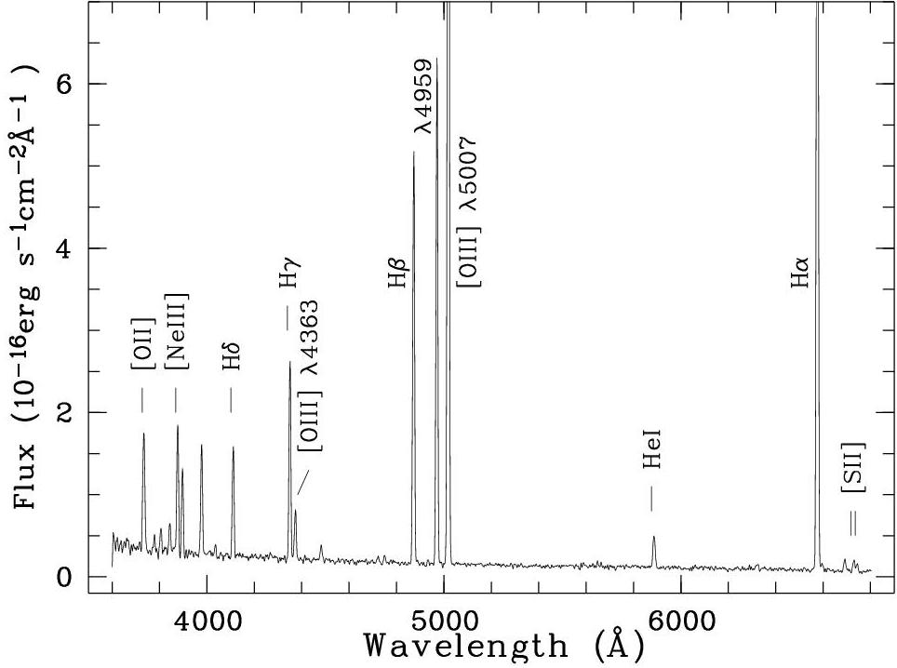
Overview
Measuring the chemical properties of gas in galaxies is essential for us to understand how galaxies evolve
These measurements are available from detecting nebular emission lines (Ha, [NII], [OII], [OIII]) in rest frame optical spectra
The most reliable chemical abundance measurements are based on the flux ratio of the [OIII] λ4363 line against [OIII] λ5007
Notes:
Measuring the chemical properties of gas in galaxies is essential for us to understand how galaxies evolve
The chemical enrichment of galaxies, driven by star formation
Stars create higher elements and release them when they die
Modulated by gas flows from supernova and cosmic accretion, is key for understanding galaxy formation and evolution.
These measurements are available from detecting nebular emission lines (Ha, [NII], [OII], [OIII]) in rest frame optical spectra
The energy levels of electrons in atoms and molecules are quantized, thus they can only absorb and emit light at specific wavelengths
The most reliable chemical abundance measurements are based on the flux ratio of the [O III] λ4363 line against [O III] λ5007
O III is double ionized oxygen
Metallicity is the fraction of the galaxy’s mass that is not H or He.
From this ratio we can determine the oxygen-to-hydrogen (O/ H) abundance (Aller 1984 ; Izotov et al. 2006).

Slide 3
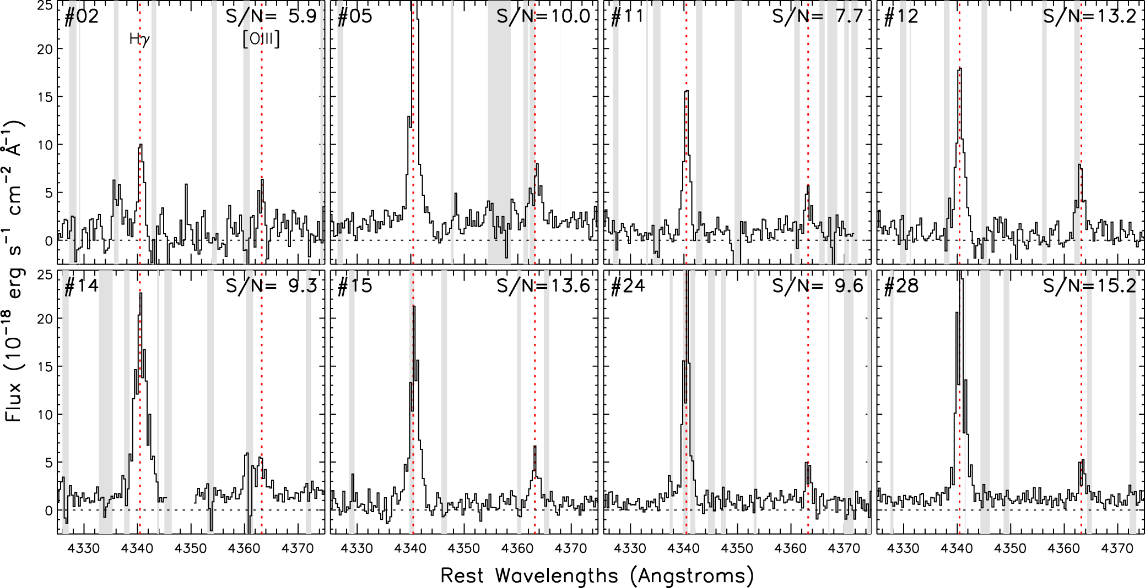
Statement of the Problem
Detecting [OIII] λ4363 is difficult in high redshift galaxies
Using the DEEP2 Galaxy Redshift Survey, 28 metal poor and high redshift galaxies were selected for this study, due to their clear [OIII] λ4363 detections
Notes:
Detecting [O III] λ 4363 is difficult, because it is weak and almost undetectable in metal-rich galaxies.
[OIII] is overshadowed by other stronger emission lines near it
Using the DEEP2 Galaxy Redshift Survey, 28 low metallicity and high redshift galaxies were selected for this study, due to their clear [O III] λ4363 detections.
These metal poor galaxies are especially interesting because they are either
In their earliest stages of formation
Accreting metal-poor gas
Undergoing significant metal enriched gas outflows.

Slide 4
Objectives
Obtain more accurate stellar masses for the 28 metal poor galaxies
Determine the mass-metallicity relationship for these galaxies
Notes:
Obtain more accurate stellar masses for the 28 metal poor galaxies.
Currently, their masses are not well known and constrained with optical data
Most common stars are Red dwarfs that emit in Near and Far infrared
Determine the mass metallicity relationship for these galaxies

Slide 5
Analysis Techniques
Gather infrared photometric data from the Spitzer Space Telescope
Aperture photometry performed on the Spitzer data yielded stellar continuum light from such galaxies
These measurements were used to construct the spectral energy distribution and model it to infer masses
Notes:
In order to accomplish these objectives, here are some of the analysis techniques we used
Infrared photometric data from the Spitzer Space Telescope.
Aperture photometry performed on the Spitzer data yielded stellar continuum light from such galaxies.
Aperture Photometry is measuring the flux from an object
Applied aperture correction and subtracted flux from sky
These measurements, combined with those at other wavelengths, were used to construct the spectral energy distribution and model it to infer masses.
Point to example, Spitzer points
SED shows how bright the galaxy is at different wavelengths
These galaxies are can be about 100 times less than then Milky way

Slide 7
Results
Positive mass-metallicity correlation, with significant dispersion
Mass-metallicity relationship varies less with mass in higher redshift galaxies than nearby galaxies or with Ly et al. 2016
Notes:
As shown on the graph, we found that there is a positive mass metallicity correlation, with significant dispersion between the galaxies and the relation.
The mass-metallicity relationship varies less with mass in higher redshift galaxies than nearby galaxies or with Ly et al. 2016
Total change now about 4 dex vs about 8 dex for Ly, 10 dex A&M
Possibly due to high number of non detections from Spitzer (about a third of galaxies were detected)
Start at about the same metallicity as A&M, but quickly diverges from each other

Slide 8
Conclusion
The most reliable method for determining the metallicity of a galaxy is the flux ratio of the [OIII] λ4363 line against [OIII] λ5007
28 high redshift galaxies were selected for this study, due to their clear [OIII] λ4363 detections
Infrared photometric data from the Spitzer Space Telescope was used to construct spectral energy distributions and models to infer masses
Mass-metallicity relation with Spitzer masses is weaker than z~0.1
Notes:
In conclusion, the most reliable method for determining the metallicity of a galaxy is the flux ratio of the [O III] λ4363 line against [O III] λ5007.
28 high redshift galaxies were selected for this study, due to their clear [O III] λ4363 detections.
Infrared photometric data from the Spitzer Space Telescope was used to construct spectral energy distributions and models to infer masses.
Mass-metallicity relation with Spitzer masses is weaker than z~0.1

Slide 9
Thank You

